Slide 1
Focus: How can we effectively use documents to support our thesis?
Do Now: Review with a partner, define Hellenism and list the different regions Alexander the Great conquered.

Slide 2
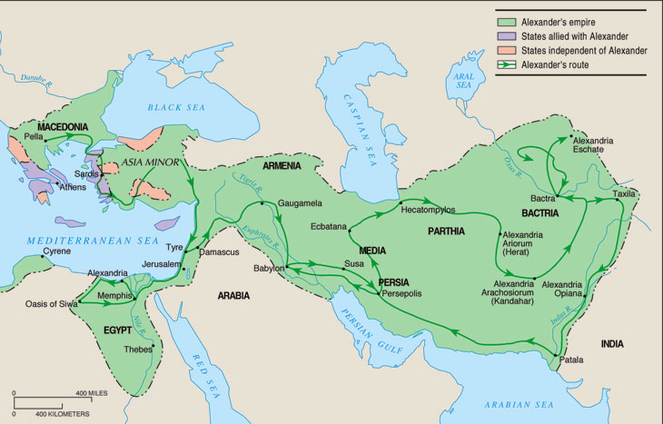
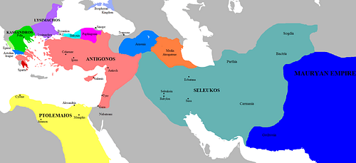
The artwork and cultural influence after Alexander's death was spread all over the regions that he had conquered.
After his death, his empire was split into three major polities by his generals. The Antigonids, the Seleucids and the Ptolemies.

Slide 3
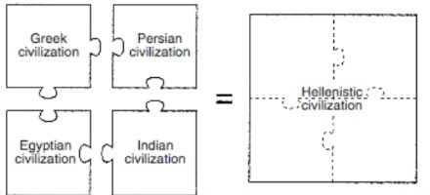
Alexander’s policies lead to cultural diffusion/syncretism among the areas he conquered:
Throughout the Middle East, people adopted Greek customs (laws, calendar, money), traditions, and language.
As Greek culture spread eastward, it blended with other cultures. This blend of eastern and western cultures is called Hellenism. The word comes from the Greek word “Hellas”, which means “their own land” or “Greece.” An important new Hellenistic Culture emerged - blending of Greek, Persian, Egyptian, and Indian influences.
This Hellenistic culture would
flourish and thrive for several
centuries.

Slide 4
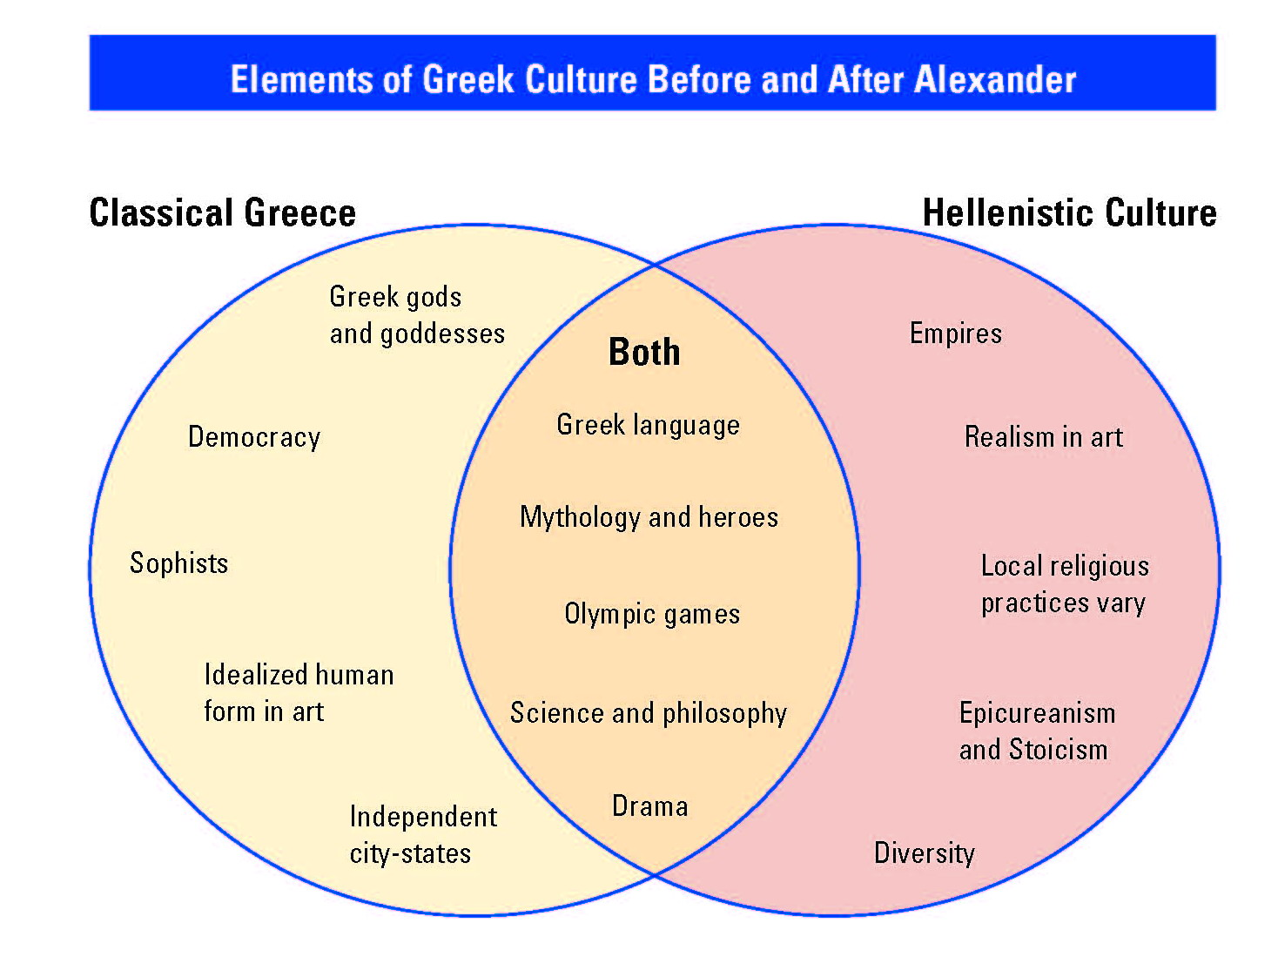
a paid teacher of philosophy and rhetoric in ancient Greece, associated in popular thought with moral skepticism and specious reasoning.

Slide 5
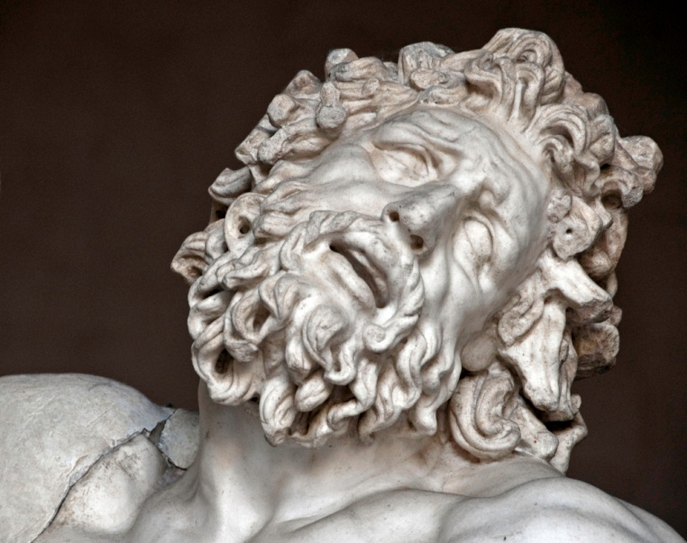
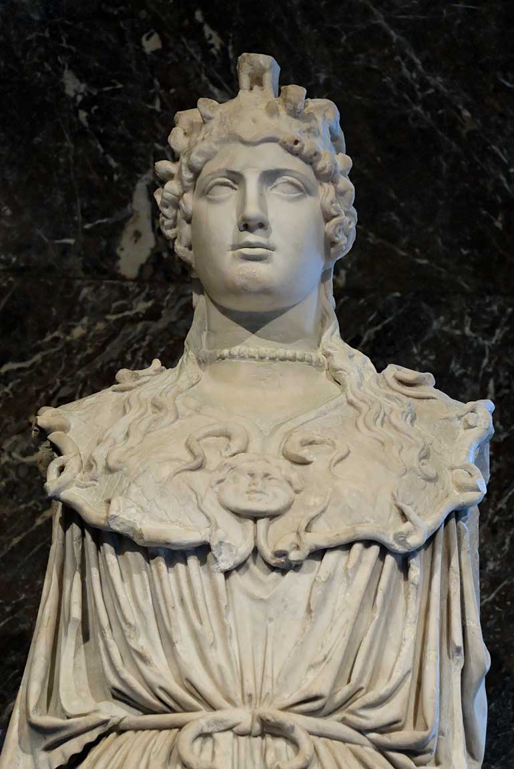
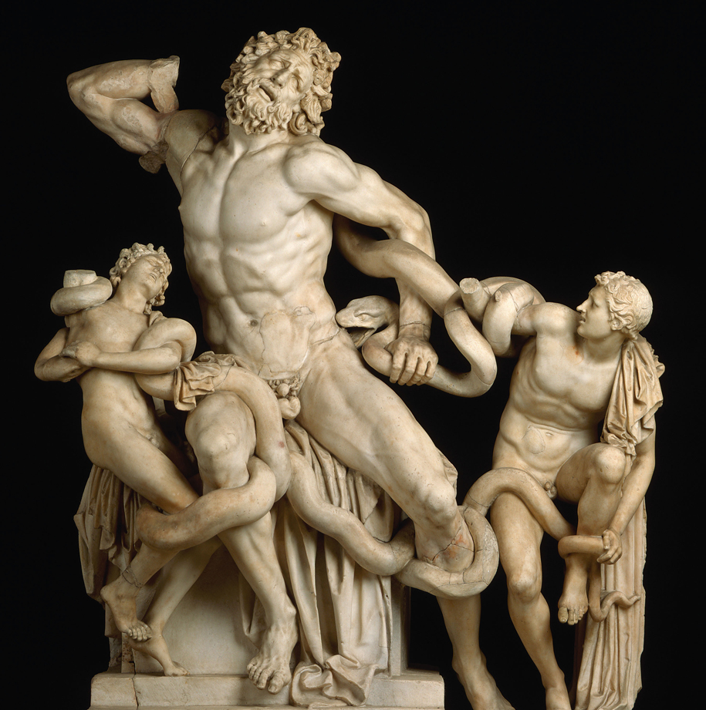
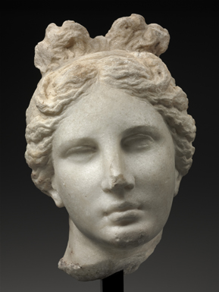
Document A:
Hellenistic – Laocoon
Hellenistic sculptors looked to Greek models and adopted their focus on realism and human anatomy.
Hellenic – Athena

Slide 6
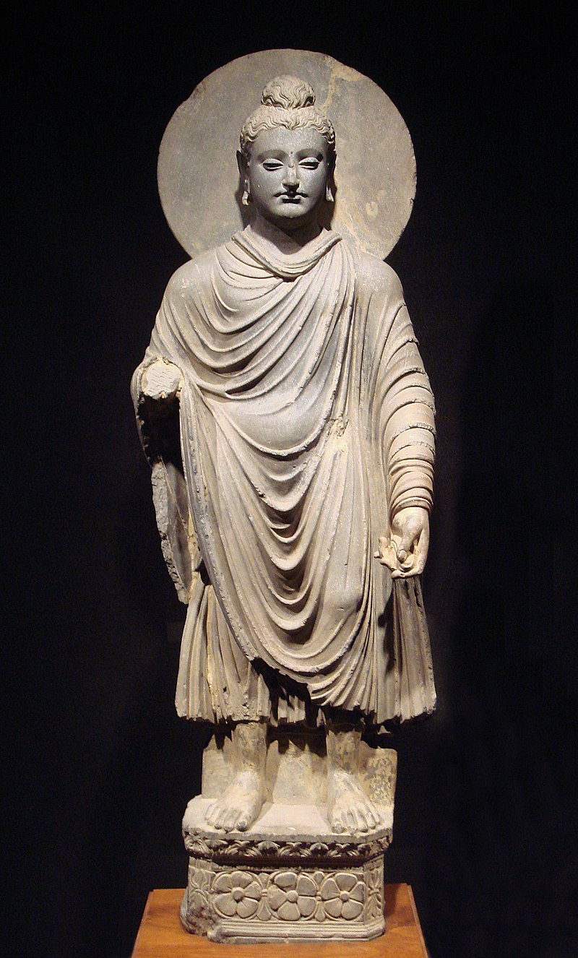
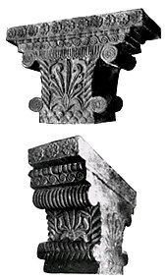
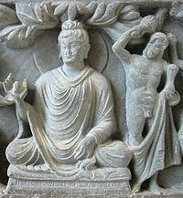
Document B:
The Buddha, accompanied by a Bodhisattva or enlightened protector. In this depiction, the Bodhisattva is heavily modeled after the Greek figure of Heracles (Hercules), son of Zeus.
Administrative buildings in the
Capital city of Maurya heavily
featured Greek influence in its
architectural style. ~3RD Century
BCE.
The Buddha, sculpted in the Greco-Indian
style. Before Greek influence it was seen
as inappropriate to depict the Buddha in art.

Slide 7
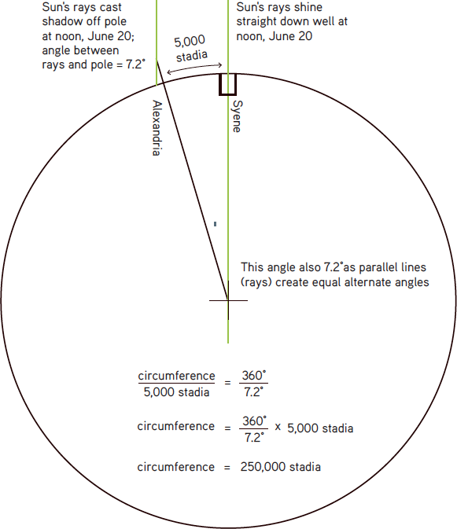
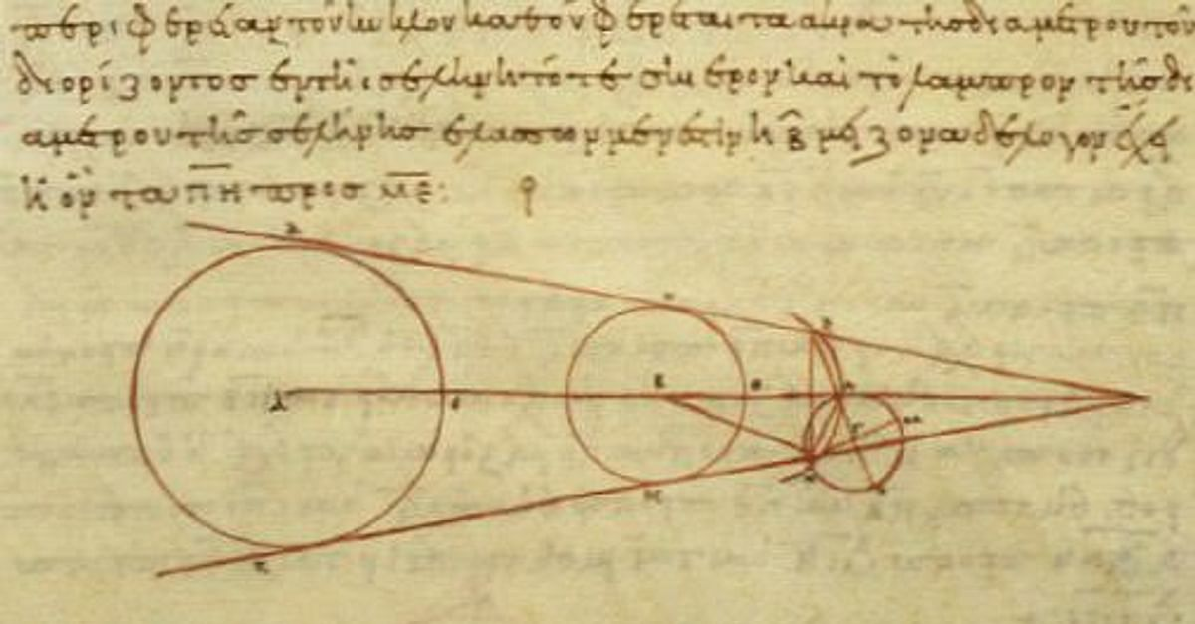
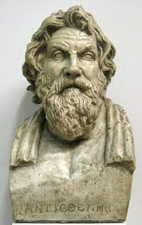
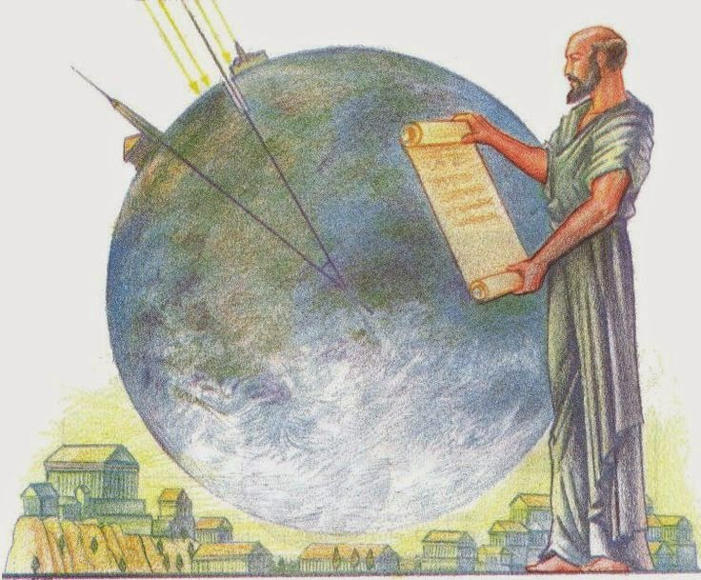
Hellenistic – Aphrodite of Melos (Venus de Milo)
Document C:
Aristarchus of Samos
hypothesized that the sun
was much larger than the
Earth and that the Sun was
the center of the universe.
310-230 BCE Alexandria, Egypt
Eratosthenes (276-194 BCE) accurately assesses the Earth’s circumference using the distance between two Egyptian cities and simple geometry and algebra.

Slide 8
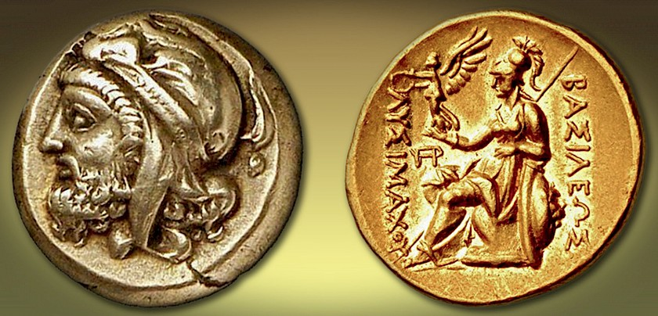
Document D:
Anatolian
Luna God
Mēn
Aphrodite
Greek Goddess
of love, beauty
and femininity.
Queen Amastris (339-285BCE), the niece of Darius III was the
last surviving Achaemenid Princess. She oversaw the city Heraclea which was a mixture of Greek, Macedonian and
Persian culture. She minted coins with Greek letter which said “Basilissês Amastrios,” Royal Queen Amastris.

Slide 9
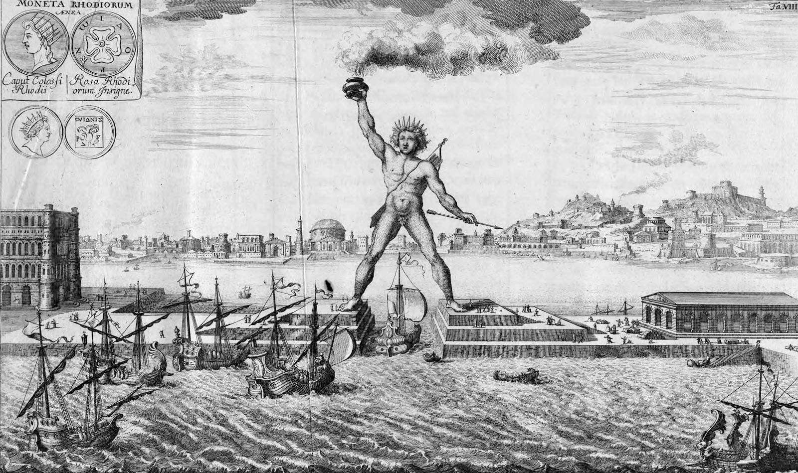
Document E:
Hellenistic – Statue of Eros sleeping
The Colossus of Rhoades; constructed in Rhoades in 280 BCE, an island in Greece’s archipelago close to Anatolia. This statue of the
Greek Sun God Helios was said to be roughly the size of the statue of liberty; about 100 feet.

Slide 10
“Art reflects the values of society” - in what ways did Alexander the Greats’ expansion influence a change in politics and philosophy?
New Perspectives on Life Develop
Characteristics of Hellenistic Culture
Two qualities of Hellenistic Culture: universalism and individualism.
The Greek outlook became universal or cosmopolitan (multinational).
Before it had been based on the polis and shared by all the citizens of the polis.
Individualism developed because the group ties of the polis had been dissolved.
Epicureanism: free yourself from the fear of death and live for pleasure.
Stoicism: know the order of the universe and submit to it. Then follow your public duty.
What connections can be made between Greek Philosophy and other world philosophies?

